Slide 1
Unit-III: Non-linear Data Structure-Tree
Basic Terminology of Trees, Binary Tree, Threaded Binary Tree, Binary Search Tree, B & B+ Tree, AVL Tree, Splay Tree and Applications of Trees

Slide 2
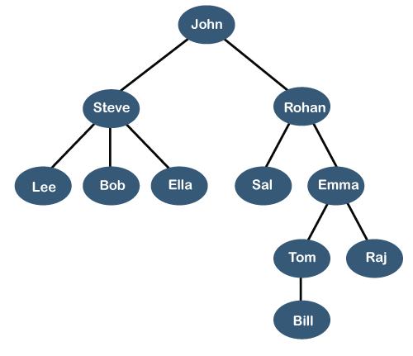
Non-linear Data Structure-Tree
A tree is also one of the data structures that represent hierarchical data.
Suppose we want to show the employees and their positions in the hierarchical form then it can be represented as shown below:

Slide 3
Non-linear Data Structure-Tree
A tree data structure is defined as a collection of objects or entities known as nodes that are linked together to represent or simulate hierarchy.
A tree data structure is a non-linear data structure because it does not store in a sequential manner. It is a hierarchical structure as elements in a Tree are arranged in multiple levels.
In the Tree data structure, the topmost node is known as a root node. Each node contains some data, and data can be of any type. In the above tree structure, the node contains the name of the employee, so the type of data would be a string.
Each node contains some data and the link or reference of other nodes that can be called children.

Slide 4
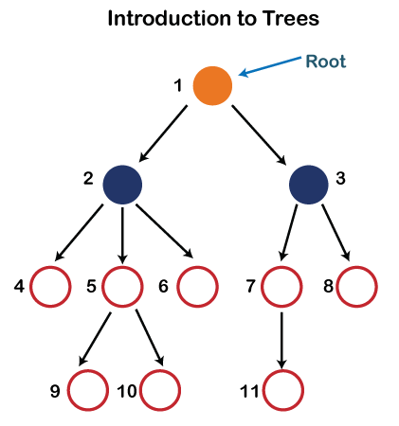
Non-linear Data Structure-Tree
Root: The root node is the topmost node in the tree hierarchy. In other words, the root node is the one that doesn't have any parent. In the above structure, node numbered 1 is the root node of the tree. If a node is directly linked to some other node, it would be called a parent-child relationship.
Child node: If the node is a descendant of any node, then the node is known as a child node.
Parent: If the node contains any sub-node, then that node is said to be the parent of that sub-node.
Sibling: The nodes that have the same parent are known as siblings.

Slide 5
Non-linear Data Structure-Tree
Leaf Node:- The node of the tree, which doesn't have any child node, is called a leaf node. A leaf node is the bottom-most node of the tree. There can be any number of leaf nodes present in a general tree. Leaf nodes can also be called external nodes.
Internal nodes: A node has atleast one child node known as an internal
Ancestor node:- An ancestor of a node is any predecessor node on a path from the root to that node. The root node doesn't have any ancestors. In the tree shown in the above image, nodes 1, 2, and 5 are the ancestors of node 10.
Descendant: The immediate successor of the given node is known as a descendant of a node. In the above figure, 10 is the descendant of node 5.

Slide 6

A Binary Tree

Slide 7
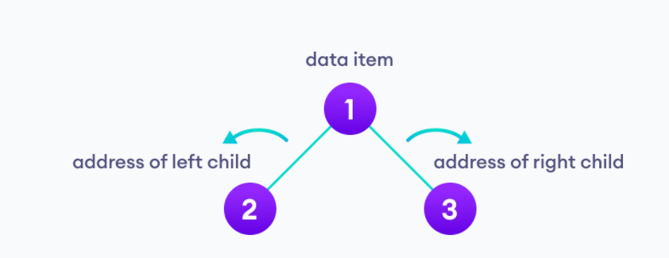
Non-linear Data Structure-Tree
What is a Binary Tree?
Binary Tree:
A binary tree is a tree data structure in which each parent node can have at most two children. Each node of a binary tree consists of three items:
data item
address of left child
address of right child

Slide 8
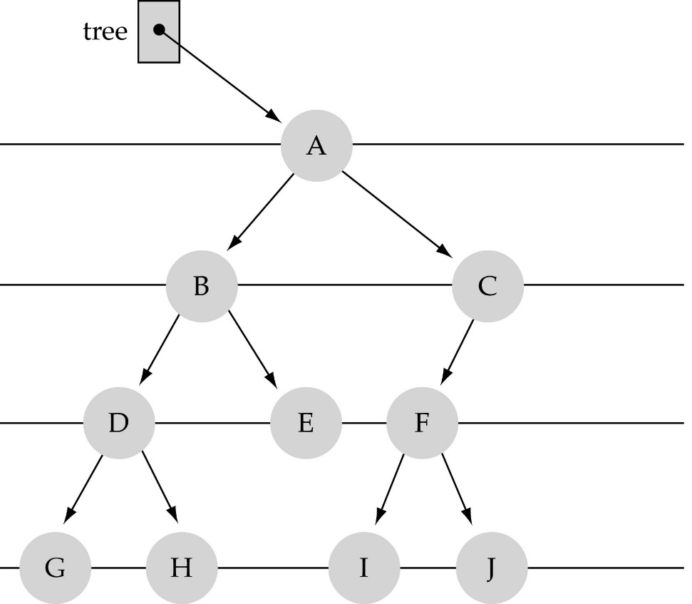
What is a Binary Tree?
Property 1: Each node can have up to two successor nodes.

Slide 9
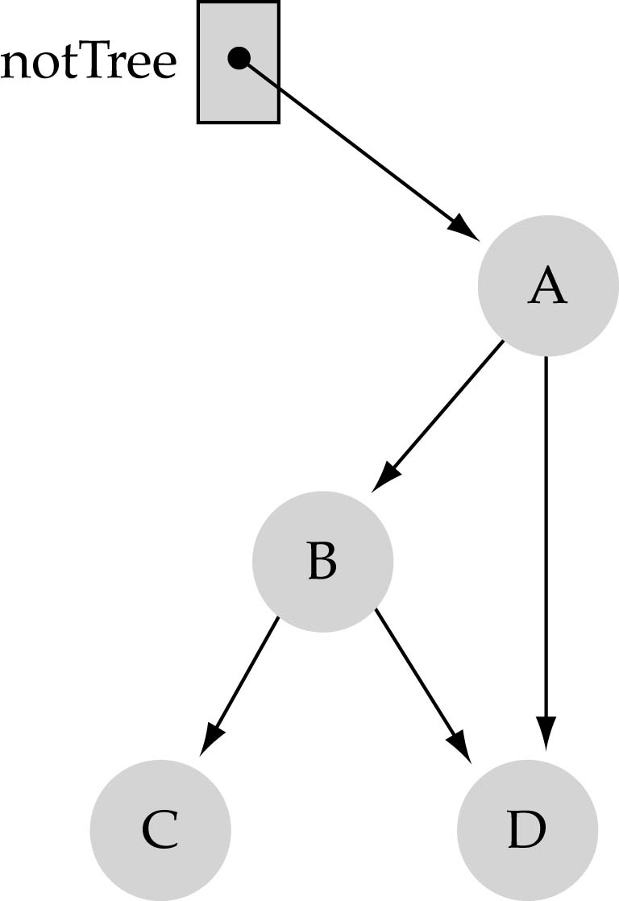
What is a Binary Tree?
Property 2: a unique path exists from the root to every other node
Not a valid binary tree!

Slide 10
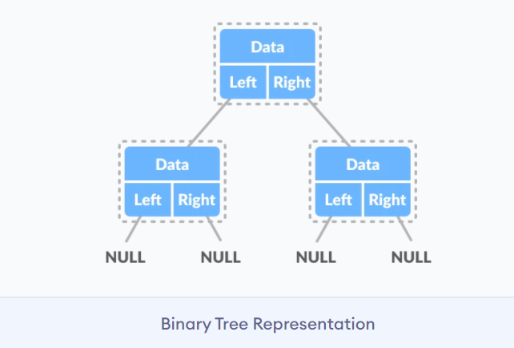
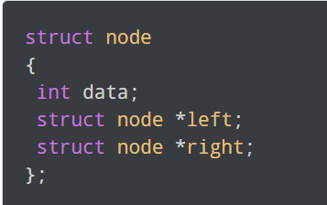
Binary Tree: Structure of a Node

Slide 11
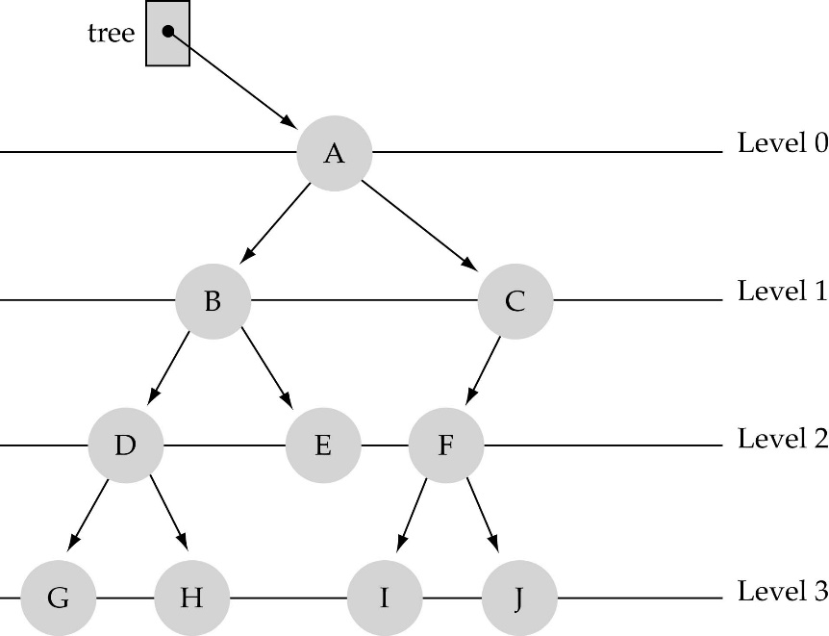
Basic Terminology
Nodes are organize in levels (indexed from 0).
Level (or depth) of a node: number of edges in the path from the root to that node.
Height of a tree h: #levels = L (some books define h as number of levels-1).
Full tree: every node has exactly two children and all the leaves are on the same level.
not full!

Slide 12
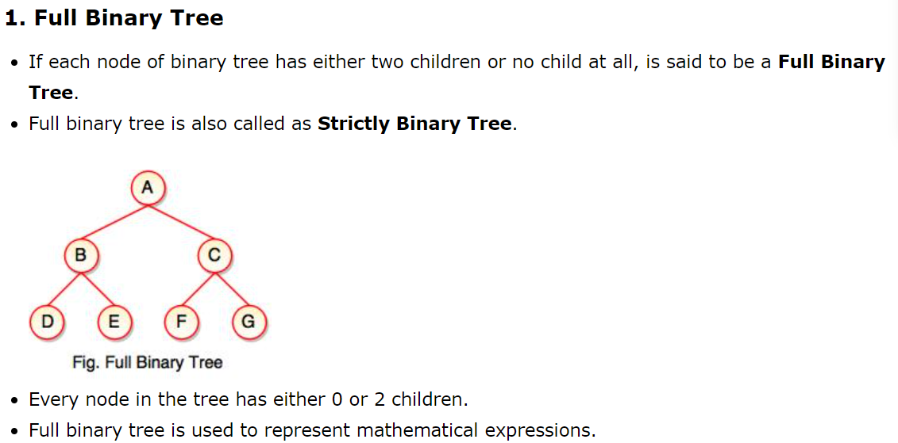
Types of Binary Tree

Slide 13
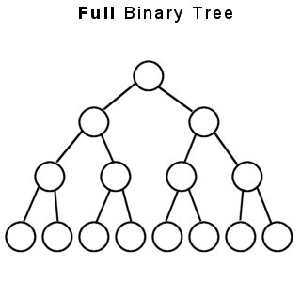
A full binary tree of a given height h has 2^{h+1}– 1
nodes.
2⁴-1=15 nodes
3

Slide 14
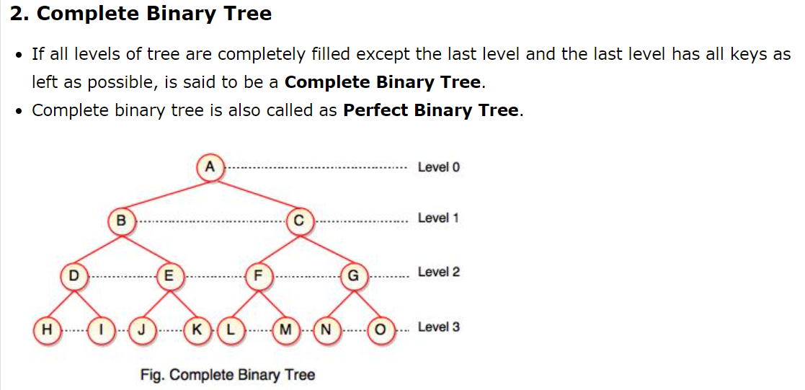
Types of Binary Tree

Slide 15
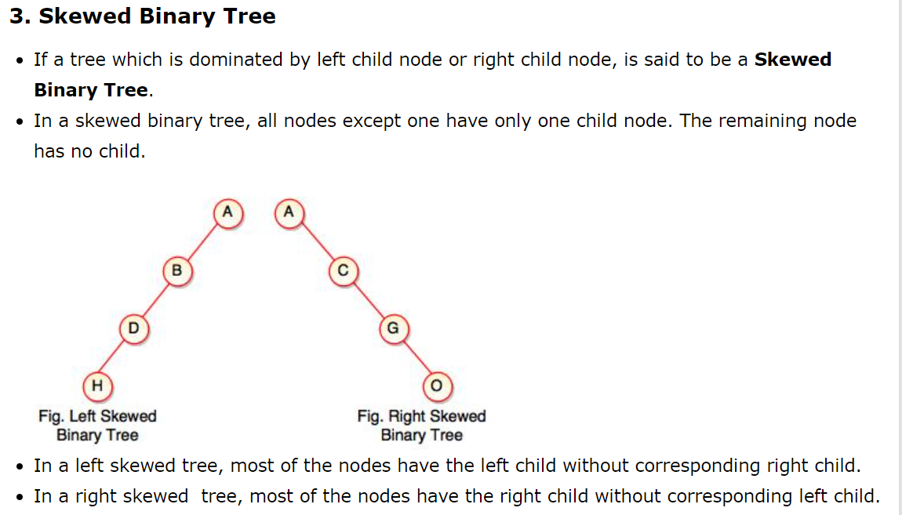
Types of Binary Tree

Slide 16
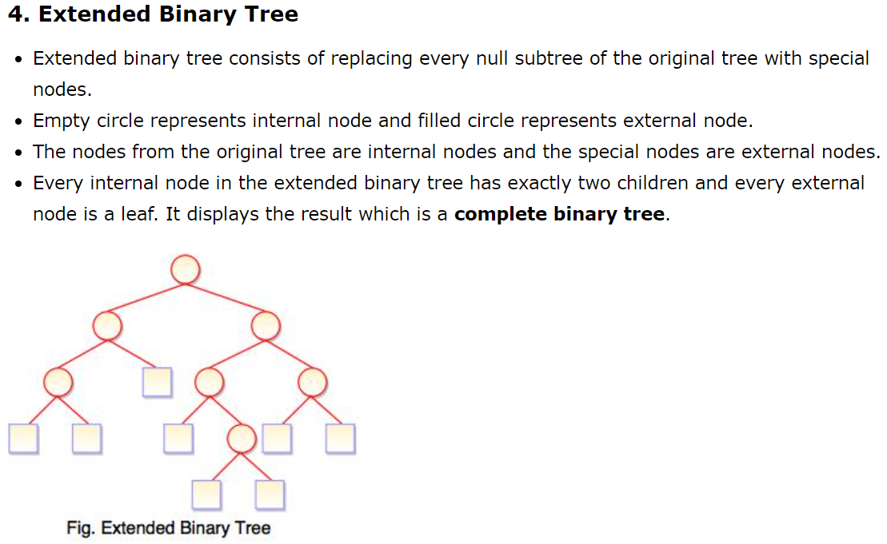
Types of Binary Tree

Slide 17

What is the max number of nodes at any level l ?
The maximum number of nodes at any level l is less than or equal to 2^{l} where l=0, 1, 2, 3,….. L-1
where l=0,1,2, ...,L-1

Slide 18
What is the total number of nodes N of a full tree with height h?
+1
l=0
l=1
l=h-1
Derived according to the geometric series:

Slide 19
What is the height h of a full tree with N nodes?

Slide 20
Why is h important?
The Tree operations like insert, delete, retrieve etc. are typically expressed in terms of the height of the tree h.
So, it can be stated that the tree height h determines running time!

Slide 21
Representation of Binary tree in memory
Let T be a binary.
There are two ways for representing binary tree in memory.
Sequential Representation
Linked Representation

Slide 22
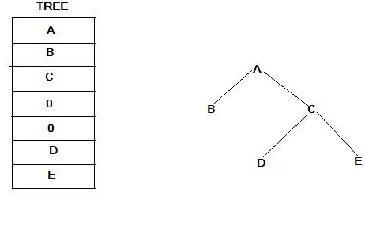
Sequential Representation
Suppose T is a complete binary tree. Then only single linear array TREE is used as follows.

Slide 23
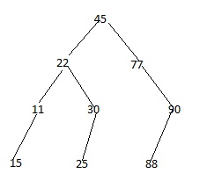

Slide 24
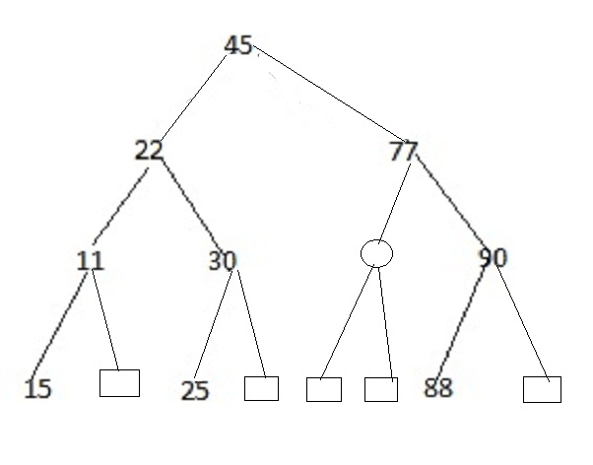
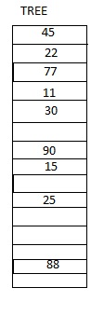
1 2 3 4 5 6 7 8 9 10 11 12 13 14 15
Height=depth=h
Space requirement=2^{h}-1=15

Slide 25
Binary tree representations (using array)
If a complete binary tree with n nodes is represented sequentially, then for any node with index i, 1 ≤ i ≤ n, we have
parent(i) is at ⎣i /2⎦ if i ≠ 1. If i = 1, i is at the root and has no parent.
LeftChild(i) is at 2i if 2i ≤ n. If 2i > n, then i has no left child.
RightChild(i) is at 2i+1 if 2i+1 ≤ n. If 2i +1 > n, then i has no left child.
A
1
[1]
[2]
[3]
[4]
[5]
[6]
[7]
A B C — D — E
B
2
C
3
Level 1
Level 2
Level 3
D
E
4
5
6
7

Slide 26

Linked Representation
We use double linked list to represent a binary tree. In a double linked list, every node consists of three fields. First field for storing left child address, second for storing actual data and third for storing right child address.
In this linked list representation, a node has the following structure...

Slide 27
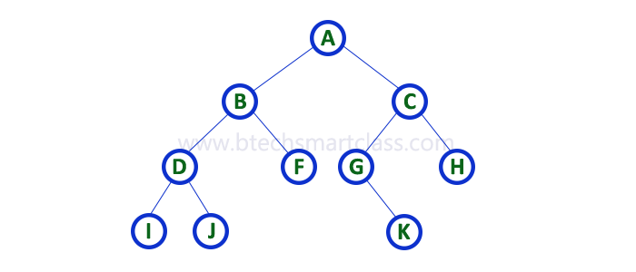
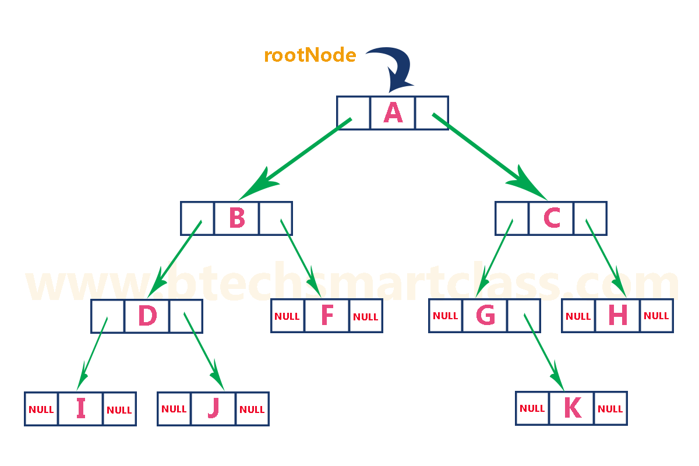
A sample representation is shown in fig.

Slide 28
S. No | Sequential Allocation | Linked Allocation
1. | Insertions and deletions are difficult. | Insertions and deletions can be done easily.
2. | It needs movements of elements for insertion and deletion. | It does not need movement of elements for insertion and deletion.
3. | In it space is wasted. | In it space is not wasted.
4. | It is more expensive. | It is less expensive.
5. | It requires less space as only information is stored. | It requires more space as pointers are also stored along with information.
6. | Its size is fixed. | Its size is not fixed.
7. | It can not be extended or reduced according to requirements. | It can be extended or reduced according to requirements.
8. | Same amount of time is required to access each element. | Different amount of time is required to access each element.
9. | Elements are stored in consecutive memory locations. | Elements may or may not be stored in consecutive memory locations.
10. | If have to go to a particular element then we can reach there directly. | If we have to go to a particular element then we have to go through all those elements that come before that element.

Slide 29

Binary Search Tree By Mrs. Amruta Hingmire Rscoe

Slide 30
Binary Search
Consider that you want to find the location of some word in a dictionary.
I guess you are not fool enough to search it in a linear way or in other words apply linear search. That is no one search page by page from the start to end of the book.
Rather, I guess you will open or divide the dictionary in the middle to determine which half contains the word.
Then consider new probable half and open or divide that half in the middle to determine which half contains the word. This process goes on.
Eventually you will find the location of the word and thus you are reducing the number of possible locations for the word in the dictionary.

Slide 31

How to search a binary tree?
Start at the root
Search the tree level by level, until you find the element you are searching for or you reach a leaf.
Is this better than searching a linked list?
No →→ O(N)

Slide 32
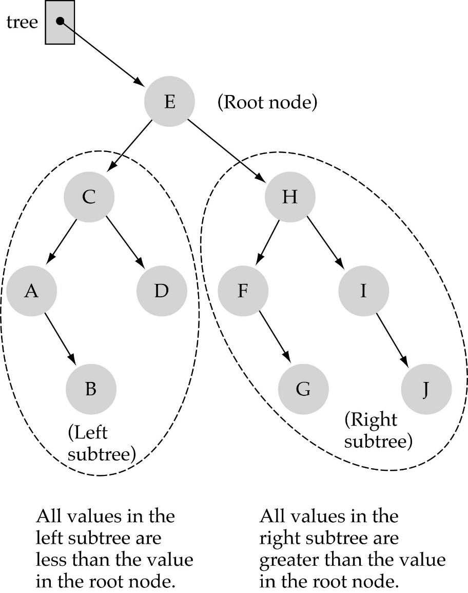
Binary Search Trees
Binary Search Tree Property:
The value stored at
a node is greater than
the value stored at its
left child and less than
the value stored at its
right child

Slide 33

Binary Search Trees
In a BST, the value stored at the root of a subtree is greater than any value in its left subtree and less than any value in its right subtree!

Slide 34

Binary Search Trees
Where is the smallest element?
Ans: leftmost element
Where is the largest element?
Ans: rightmost element

Slide 35

How to search a binary search tree?
Start at the root
Compare the value of the item you are searching for with the value stored at the root
If the values are equal, then item found; otherwise, if it is a leaf node, then not found

Slide 36
How to search a binary search tree?
If it is less than the value stored at the root, then search the left subtree
If it is greater than the value stored at the root, then search the right subtree
Repeat steps 2-6 for the root of the subtree chosen in the previous step 4 or 5

Slide 37
How to search a binary search tree?
Is this better than searching
a linked list?
Yes !! → → O(logN)

Slide 38
Difference between BT and BST
A binary tree is simply a tree in which each node can have at most two children.
A binary search tree is a binary tree in which the nodes are assigned values, with the following restrictions :
No duplicate values.
The left subtree of a node can only have values less than the node
The right subtree of a node can only have values greater than the node and recursively defined
The left subtree of a node is a binary search tree.
The right subtree of a node is a binary search tree.

Slide 39
Binary Tree Search Algorithm
struct node* search(struct node* root, int key)
{
// Base Cases: root is null or key is present at root
if (root == NULL || root->key == key)
return root;
// Key is greater than root's key
if (root->key < key)
return search(root->right, key);
// Key is smaller than root's key
return search(root->left, key);
}

Slide 40
Binary Tree Search Algorithm
Example: key =4 then find(4)
Call SEARCH(x, k)
6
2
9
1
4
8

Slide 41
Binary Tree Search Algorithm
x=root
Example: k =4 and x=root
Call SEARCH(root,4)
Now x->key=6 then k<x->key
So call SEARCH(x->left, k)
6
2
9
1
4
8

Slide 42
Binary Tree Search Algorithm
Example: k =4 and x=root->left
Call TREE-SEARCH(x,4)
Now x->key=2 then k>x->key
SEARCH(x->right, k)
6
x=root->left
2
9
1
4
8

Slide 43
Binary Tree Search Algorithm
Example: k =4 and x=root->left->right
Call SEARCH(x,4)
Now x->key=4 then k=x->key
Search terminates
6
x=root->left->right
2
9
1
4
8

Slide 44
Binary Tree Search Algorithm
Example: k =4 and x=root.left.right
Now x.key=4 then k=x.key
Search terminates and x=root.left.right is the desired node or location
6
x=root->left->right
2
9
1
4
8

Slide 45
Insertion in BST – Pseudo code
if tree is empty
create a root node with the new key
else
compare key with the top node
if key = node key
replace the node with the new value
else if key > node key
compare key with the right subtree:
if subtree is empty create a leaf node
else add key in right subtree
else key < node key
compare key with the left subtree:
if the subtree is empty create a leaf node
else add key to the left subtree

Slide 46
BST Insertion Algorithm
We are supposed to insert an item value 5 and find an appropriate node z for it
6
2
9
1
4
8

Slide 47
BST Insertion Algorithm
X is root
6
2
9
1
4
8

Slide 48
BST Insertion Algorithm
X is root
Now x≠NIL and z->key<x->key
That is [5<6]
6
2
9
1
4
8

Slide 49
BST Insertion Algorithm
Z->key>x->key[5>2]
6
x
2
9
1
4
8

Slide 50
BST Insertion Algorithm
Z->key>x->key[5>4]
6
x
2
9
1
4
8

Slide 51
BST Insertion Algorithm
So x->right=z that is
6
x
2
9
1
4
8
z
5

Slide 52
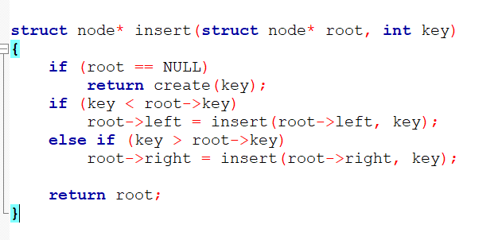
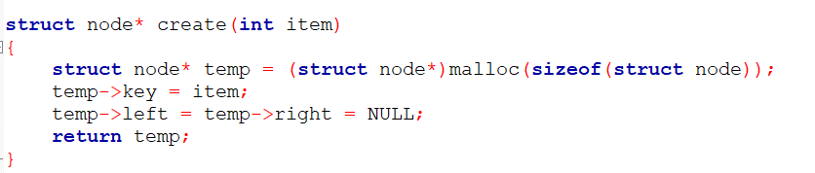
Insertion in BST – Pseudo code

Slide 53
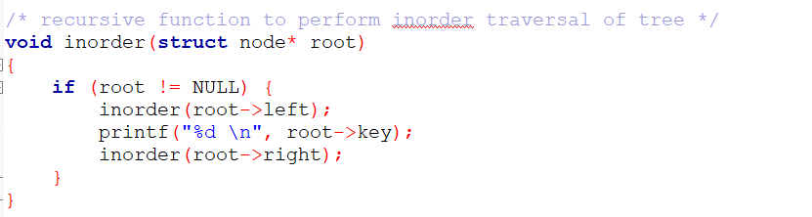
Traversal/Display in BST – Pseudo code

Slide 54
Delete a value from the BST
Removing a node from a BST is a bit more complex, since we do not want to create any "holes" in the tree. The intention is to remove the specified item from the BST and adjusts the tree
The binary search algorithm is used to locate the target item: starting at the root it probes down the tree till it finds the target or reaches a leaf node (target not in the tree)

Slide 55
Delete a value from the BST
Experimenting the cases:
if the tree is empty return false
else Attempt to locate the node containing the target using the binary search algorithm:
if the target is not found return false
else the target is found, then remove its node. Now while removing the node four cases may happen

Slide 56
Delete a value from the BST
Case 1: if the node has 2 empty subtrees
- replace the link in the parent with null
Case 2: if the node has a left and a right subtree
- replace the node's value with the max value in the
left subtree
- delete the max node in the left subtree
Case 3: if the node has no left child
- link the parent of the node to the right
(non-empty) subtree
Case 4: if the node has no right child
- link the parent of the target to the left
(non-empty) subtree

Slide 57
Delete a value from the BST
Case 1: removing a node with 2 EMPTY SUBTREES -replace the link in the parent with null
Removing 4
Parent
7
7
5
9
5
9
Z
4
6
8
10
6
8
10

Slide 58
Delete a value from the BST
Case 2: removing a node with 2 SUBTREES
- replace the node's value with the max value in the left subtree
- delete the max node in the left subtree
Z
Removing 7
7
6
5
9
5
9
4
6
8
10
4
8
10

Slide 59
Delete a value from the BST
Case 3: if the node has no left child
- link the parent of the node to the right (non-empty) subtree
Parent
Parent
Removing 5
Z
7
7
5
9
9
6
6
8
10
8
10

Slide 60
Delete a value from the BST
Case 4: if the node has no right child
- link the parent of the node to the left (non-empty) subtree
Parent
Parent
Removing 5
Z
7
7
5
9
9
4
4
8
10
8
10

Slide 61
Analysis of BST Operations
The complexity of operations search, insert and remove in BST is O(h) , where h is the height.
When the tree is balanced then it is O(log n). The updating operations cause the tree to become unbalanced.
The tree can degenerate to a linear shape (skewed tree)and the operations will become O (n)

Slide 62
Applications for BST
Binary Search Tree: Used in many search applications where data is constantly entering/leaving, such as the map and set objects in many languages' libraries.
Binary Space Partition: Used in almost every 3D video game to determine what objects need to be rendered.
Binary Tries: Used in almost every high-bandwidth router for storing router-tables.
Heaps: Used in implementing efficient priority-queues. Also used in heap-sort.
Huffman Coding Tree:- used in compression algorithms, such as those used by the .jpeg and .mp3 file-formats.
GGM Trees - Used in cryptographic applications to generate a tree of pseudo-random numbers.
Syntax Tree: Constructed by compilers and (implicitly) calculators to parse expressions.

Slide 63
Does the order of inserting elements into a tree matter?
Yes, certain orders might produce very unbalanced trees or degenerated trees!
Unbalanced trees are not desirable because search time increases!
Advanced tree structures, such as red-black trees, AVL trees, guarantee balanced trees.

Slide 64
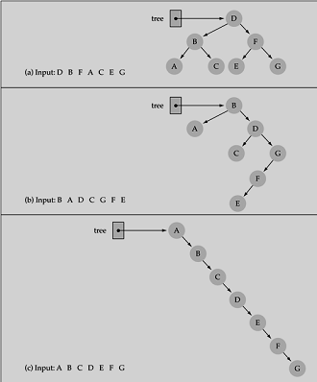
Does the order of inserting elements into a tree matter?

Slide 65
Better Search Trees
Prevent the degeneration of the BST :
A BST can be set up to maintain balance during updating operations (insertions and removals)
Types of ST which maintain the optimal performance in other words balanced trees:
splay trees
AVL trees
2-4 Trees
Red-Black trees
B-trees

